Slide 1
Chapter 9
E-strategy, Internet Communities, and Global EC

Slide 2
Learning Objectives
In this chapter, you will learn about:
Planning electronic commerce initiatives
Strategies for developing electronic commerce Web sites
Managing electronic commerce implementations

Slide 3
Identifying Benefits and Estimating Costs of Electronic Commerce Initiatives
Information technology projects
  Keys to successful implementation
    Planning and execution
Successful electronic commerce initiative business plan activities
  Identifying initiative’s specific objectives
  Linking objectives to business strategies
Setting electronic commerce initiative objectives
  Consider strategic role of project, intended scope, resources available

Slide 4
Identifying Objectives
Typical business electronic commerce objectives
  Increasing existing market’s sales
  Opening new markets
  Serving existing customers better
  Identifying new vendors
  Coordinating more efficiently with existing vendors
  Recruiting employees more effectively
Objectives vary with organization size
Compare e-commerce risk to inaction risk

Slide 5
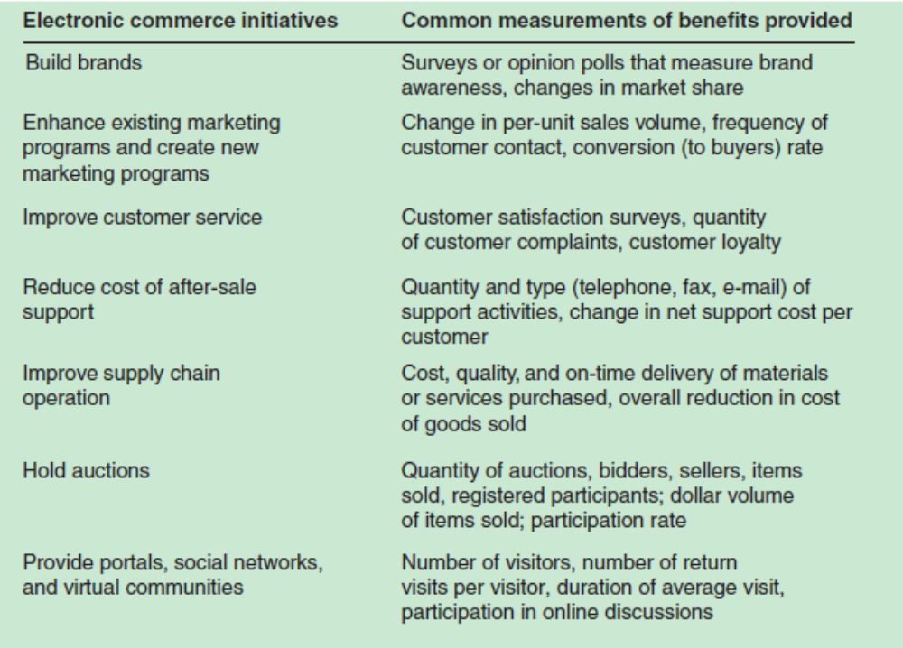
FIGURE 11-1 Measuring the benefits of electronic commerce initiatives

Slide 6
Identifying and Estimating Costs
Information technology project costs
  Difficult to estimate and control
Web development
  Uses rapidly changing hardware and software technologies
    Hardware costs are downward
  Increasing software sophistications
    Provides ever-increasing demand for more newer, cheaper hardware
    Yields net increase in overall hardware costs

Slide 7
Identifying and Estimating Costs (cont’d.)
  Total cost of ownership (TCO)
  Includes all costs related to activity
Electronic commerce implementation TCO includes:
  Hardware costs, software costs, outsourced design work, employee salaries and benefits, site maintenance
Good TCO number
  Includes assumptions about how often site would need to be redesigned in the future

Slide 8
Identifying and Estimating Costs (cont’d.)
  Opportunity cost
  Cost of not undertaking an initiative
  Largest and most significant costs associated with electronic commerce initiative
  Foregone benefits that company could have obtained from electronic commerce initiative not pursued

Slide 9
Identifying and Estimating Costs (cont’d.)
Web site costs
  Total dollar amounts required to create and operate a Web site
    Varied over the years
  Relative proportion of costs remained stable
    10 percent: computer hardware
    10 percent: software
    80 percent: labor
  Annual cost of operating an online business Web site
    Remained stable
    Ranges between 50 and 200 percent of site initial cost

Slide 10
Comparing Benefits to Costs
Capital projects (capital investments)
  Major investments in equipment, personnel, other assets
  Techniques to evaluate proposed capital projects
    Range from simple calculations to complex computer simulation models
    Reduce to comparison of benefits and costs

Slide 11
Comparing Benefits to Costs (cont’d.)
Key parts of creating electronic commerce initiatives business plan
  Identify potential benefits
  Identify costs required to generate benefits
  Evaluate whether benefits exceed costs

Slide 12
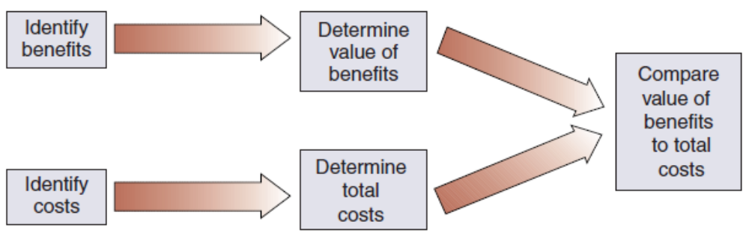
FIGURE 11-4 Cost/benefit evaluation of electronic commerce strategy elements

Slide 13
Return on Investment (ROI)
Return on investment (ROI) techniques
  Measures amount of income (return) provided by specific current expenditure (investment)
  Examples:
    Payback method, net present value method, internal rate of return
  Provides quantitative expression of comfortable benefit-to-cost margin
  Mathematically adjusts for future reduced value of benefits

Slide 14
Return on Investment (ROI) (cont’d.)
Electronic commerce initiatives
  Seen as absolutely necessary investments
  Not always subjected to close examination, rigid requirements
  Companies fear being left behind
Perceived value in new market early positioning allows:
  Many companies to invest large amounts of money
    With few near-term profit prospects
  Example: first wave of newspaper Web sites

Slide 15
Internal Development vs. Outsourcing
Initiative’s success dependency
  How well initiative integrates into and supports business activities
Internal people leading projects ensures:
  Company’s specific needs are addressed
  Initiative congruent with organization goals, culture
Outside consultants
  Seldom able to learn enough about organization’s culture to accomplish objectives

Slide 16
Staffing for Electronic Commerce
Chief information officer (CIO)
  Organization’s top technology manager
  Responsibilities
    Overseeing all information systems and related technological elements required to undertake and operate online business activities
Business manager
  Member of internal team setting project objectives
  Responsible for implementing business plan elements, reaching objectives set by internal team

Slide 17
Staffing for Electronic Commerce (cont’d.)
Project manager
  Person with specific training, skills in tracking costs and accomplishment of specific project objectives
Project portfolio manager
  Usually promoted from the ranks of the project managers
  Responsible for tracking all ongoing projects and managing them as a portfolio
Account manager
  Keeps track of multiple Web sites in use or keeps track of projects combining into larger Web site

Slide 18
Staffing for Electronic Commerce (cont’d.)
Applications specialists
  Maintain accounting, human resources, logistics software
Web programmers
  Design and write underlying code for dynamic database-driven Web pages
Web graphics designer
  Trained in art, layout, composition
  Understands how Web pages are constructed

Slide 19
Staffing for Electronic Commerce (cont’d.)
Content creators
  Write original content
Content managers or content editors
  Purchase existing material and adapt it for use on the site
Social networking administrator
  Responsible for managing virtual community elements of the Web operation

Slide 20
Staffing for Electronic Commerce (cont’d.)
Online marketing manager
  Specializes in specific techniques used to build brands and increase market share
    Uses Web site and other online tools: e-mail marketing
Customer service personnel
  Design and implement customer relationship management activities in electronic commerce operation

Slide 21
Staffing for Electronic Commerce (cont’d.)
Call center
  Company handling incoming customer telephone calls, e-mails for other companies
  Makes sense for smaller companies
Systems administrator
  Responsible for system’s reliable, secure operation

Slide 22
Staffing for Electronic Commerce (cont’d.)
Network operations staff functions include:
  Load estimation and load monitoring
  Resolving network problems as they arise
  Designing and implementing fault-resistant technologies
  Managing any network operations outsourced to service providers or telephone companies

Slide 23
Staffing for Electronic Commerce (cont’d.)
Database administration function support activities include:
  Transaction processing, order entry, inquiry management, shipment logistics
  Activity requirements:
    Existing database into which site being integrated
    Separate database established for electronic commerce initiative

Slide 24
Change Management
Information system projects involve change
Employee concerns
  Ability to cope with changes, ability to continue to do good work, job security
Concerns lead to increased stress
Change management
  Process of helping employees cope with changes
    Includes tactics designed to help employees feel involved with change
    Helps employees overcome feelings of powerlessness

Slide 25
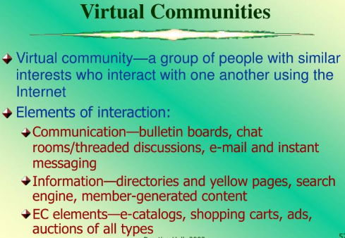
E- Business, Ninth Edition

Slide 26
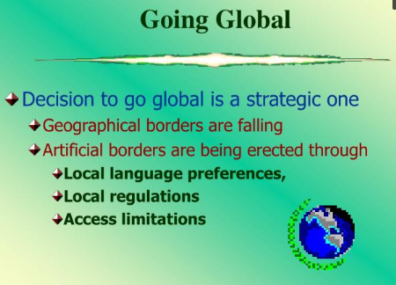
E- Business, Ninth Edition

Slide 27
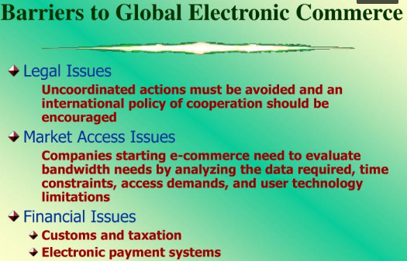
E- Business, Ninth Edition

Slide 28
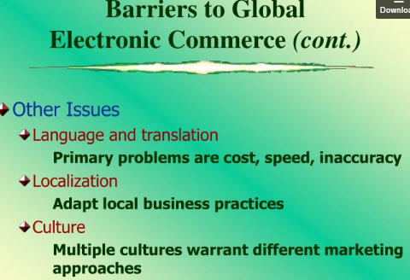
E- Business, Ninth Edition

Slide 29
Summary
Key elements of e-commerce business plans
  Setting objectives in measurable terms
    Derived from initiative’s overall goals
    Include planned benefits and planned costs
  Evaluate cost-benefit
    ROI evaluation technique
  Determine outsourcing strategy, staffing
  Project management
    Managing change
  E-community
  Going global
    Barriers

